Slide 1
Welcome to the CACFP Meal Pattern Requirements Training – Infant Feeding
Notes:
Welcome to the CAFCP Meal Pattern training. This session will focus specifically on the requirements surrounding the milk, fruit, and vegetable components in the updated CACFP meal patterns, which will go into effect on October 1, 2017.

Slide 2
Training Materials www.theicn.org/cacfpmp
Notes:
Copies of this power point as well as additional training materials can be found at the website listed on the screen. Additional training materials will be available through the RIDE Child Nutrition Programs website.

Slide 3
Child & Adult Meal Pattern Requirements Overview
Wider varieties of protein options
Greater varieties of vegetables and fruits
More whole grains
Less added sugar and saturated fat
Notes:
USDA made some policy updates to the child and adult meal patterns, including the meal pattern for infants ages 0 through 11 months. The updated child and adult meal pattern requirements, which were published in April of 2016, focus on ensuring children and adults have access to healthy, balanced meals throughout the day. Specifically, the changes provide:
Wider varieties of protein options
Greater varieties of vegetables and fruits
More whole grains
Less added sugar and saturated fat
Today, we will talk about these changes as they relate to the infant meal pattern.

Slide 4
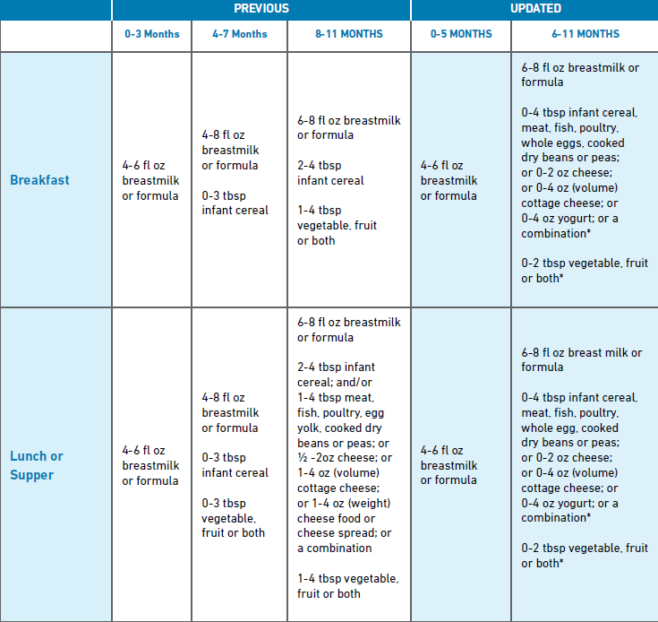
Notes:
The updated meal patterns continue to dictate the required components and minimum portion sizes that must be served as part of a reimbursable meal for each meal period. As you can see from this comparison chart, there have been several changes the infant meal pattern including changes to the age groupings, required portion sizes, and required meal components for a reimbursable infant meal.
We will be discussing each of these changes in depth throughout this training.

Slide 6
Infant Meal Pattern Requirements
Notes:
Now that we’ve looked generally at the new meal pattern for infants as compared to the current meal pattern, let’s move on to review some of the specific infant meal pattern requirements.

Slide 7
Infant Meal Pattern Requirements Overview
Meals are reimbursable when a mother breastfeeds on-site
Features two age groups: Birth-5 months & 6-11 months
Provides more nutritious meals and snacks
Vegetables & fruits must be served at snack
Juice, cheese food, or cheese spread are no longer creditable
Yogurt & whole eggs are allowable meat alternates
Notes:
SAY:
There are three major updates in the infant meal pattern requirements.
First, they encourage and support breastfeeding by providing additional reimbursement when mothers breastfeed on-site.
Second, they promote developmentally appropriate meals by separating the infant age groups into two age groups instead of three.
Third, they provide meals that are more nutritious to promote the development of healthy eating habits, by:
requiring vegetables and fruits be served at snack,
disallowing juice, cheese food, and cheese spreads as creditable items, and
allowing yogurt and whole eggs to credit as meat alternates.

Slide 8
Infant Meal Pattern Age Groups
PREVIOUS
UPDATED
Birth-3 months
4-7 months
8-11 months
Birth-5 months
6-11 months
Notes:
Let’s begin by exploring the age groups. As I mentioned, the previous meal patterns featured three age groups. However, the updated infant meal pattern requirements now feature only two age groups: Birth through the end of 5 months and 6 months through the end of 11 months. These changes align the CACFP meal pattern with the American Academy of Pediatrics recommendations as well as will the infant age groups used for WIC. Additionally, the new infant age groups are designed to help delay the introduction of solid foods until about 6 months of age.
You’ll notice that unlike many regulatory requirements that dictate service in a very black and white fashion, when talking about infants and the introduction of solid foods I used the word “about” when referring to the time that solid foods should be introduced. Throughout this entire presentation is extremely important to remember that when discussing the eating habits of infants, each individual infant should drive the process; there are certain regulatory requirements that must be met under the new CACFP meal patterns, but much of the infant feeding process is going to be dependent on what the infant is developmentally ready to receive. We will talk about developmental readiness in further depth later in this presentation.

Slide 9
Encourages Breastfeeding
Breast milk is the optimal source of nutrients
Birth through the end of 5 months
Breastmilk or infant formula is the only meal component required
Minimum serving size is 4-6 oz of breastmilk (or infant formula)
Notes:
There are several advantages for having two age groups. Let’s review some of these advantages and how they would apply when serving infants.
First, the updated infant meal pattern requirements encourage breastfeeding. Breastmilk is the optimal source of nutrients for infants, and as mentioned, it is generally the only source of nutrients infants need for healthy growth and development during the first 6 months of life. Therefore, breastmilk or formula is the only required food component for infants between the age of birth through the end of five months. For all meals and snacks, serve infants between the ages of birth through the end of 5 months a minimum of 4-6 fluid ounces of breastmilk or infant formula.

Slide 10
Promotes Developmental Readiness
Delay the introduction of solid foods until around 6 months
Most infants are not ready to consume solid foods until midway through the 1st year
Introducing solid foods too soon increases risk of obesity
Notes:
Another advantage of having two age groups is it helps to delay the introduction of solid foods until around 6 months when infants are developmentally ready to accept them.
The previous infant meal pattern requirements allowed solid foods to be introduced as early as 4 months of age. However, if infants are introduced to solid foods before they are developmentally ready, the risk of being overweight or obese later in life increases. Also, infants need time to develop the skills to eat solid foods, and most infants are not ready to consume solid foods until midway through the first year. Therefore, the two age groups support that infants will be developmentally ready to accept solid foods before, at, or after 6 months of age.
Though around 6 months is recommended timeframe for introducing solid foods, as I mentioned earlier, each individual infant should really be driving their own individual process. If there is a 5 month old infant at your center and you and the parents both agree that he or she is ready to begin solid foods, those meals could still be reimbursable provided that you meet the minimum meal pattern requirements and maintain the proper documentation. Alternately, if there is a 7 month child at your center and you and the parents both agree that he or she is not ready to be introduced to solid foods, these meals can be reimbursable as well as long as the proper documentation is maintained.
The USDA memo, CACFP 23-2016 – Feeding Infants and Meal Pattern Requirements in the CACFP; Questions and Answers, which is available on the RIDE child nutrition webpage, provides some great additional clarifications around developmental readiness including questions and answers about several specific situations that your center might encounter.

Slide 11
Allows More Nutritious Foods
Foods from all food components may be served around 6 months, when developmentally ready
Breakfast, Lunch, & Supper
Breastmilk or iron-fortified infant formula
Infant cereal, meat/meat alternates, or a combination of both
Vegetable or fruit, or a combination of both
Snack
Breastmilk or iron-fortified infant formula
Grains
Vegetable or fruit, or a combination of both
Notes:
In addition to encouraging breast feeding and focusing on developmental readiness, the updated infant meal pattern requirements allow more nutritious foods. Specifically, foods from all of the food components may be served to infants around 6 months, as it is developmentally appropriate. During breakfast, lunch, and supper meals, the following three food components must be offered to infants when they are developmentally ready to accept them:
Breastmilk or iron-fortified infant formula
Infant cereal, meat/meat alternates, or a combination
Vegetable, fruit, or a combination of both
During snacks, there are three food components:
Breastmilk or iron-fortified infant formula
Grains
Vegetable, fruit, or a combination of both

Slide 12
Focuses on Serving Sizes
Food components beginning with “zero”
Recognizes that all infants are not ready for solid foods at 6 months
By 7 or 8 months, infants should be consuming solid foods from all food groups
Serving Sizes
0-2 oz.
0-4 tbsp.
Notes:
SAY:
Except for breastmilk and infant formula, the serving sizes for all food components for meals and snacks begin with “zero” for infants 6 through 11 months. This serving size recognizes that not all infants are ready to eat solid foods right at 6 months of age and may need additional time before they are developmentally ready. It is important to note, by 7 or 8 months of age, most infants should consume solid foods from all food groups. Communication with parents will be key throughout this process; many centers may choose to have parents update an infant feeding preference form on a regular basis as a best practice as supporting documentation for which foods are developmentally appropriate for each infant in care.

Slide 13
Focuses on Eating Habits
Recognizes eating habits may change
Some infants may eat certain foods one week/day, but not the next
Meals & snacks consistent with eating habits should not be disallowed
Notes:
The last advantage we will cover is that the two age groups focus on infants eating habits. Specifically, the serving sizes also allow you to feed infants based on their eating habits with the understanding that their eating habits may change. For example, some infants may eat certain foods this week, but will not eat the same food the next week. This meal should not be disallowed, as long as the meal offered is consistent with the infants’ eating habits. We will discuss this advantage further, later in this lesson.

Slide 14
Breast Milk & Infant Formula
Notes:
Let’s move on to discuss the individual components that make up the infant meal pattern, starting with breast milk and formula.

Slide 15
Breastmilk & Infants
Promote breastfeeding by allowing reimbursement when:
a parent/guardian supplies expressed milk
Milk that is produced and expelled from the breast
a mother breastfeeds her infant on-site
Notes:
The updated infant meal pattern requirements encourage and promote breastfeeding in two key ways. First, you may continue to claim infant meals for reimbursement when a parent or guardian supplies expressed breastmilk for their infant and you feed the infant the expressed milk. This requirement is currently in effect for infant meals. Second, effective October 1, 2017, you may begin to claim reimbursement for meals when a mother breastfeeds her infant on site at the child care facility.

Slide 16
Documenting On-site Breastfeeding
Recording the total amount a mother breastfeeds her infant is not required
Acceptable ways to document:
Breastfed on-site
Mother on-site
May use existing forms to reduce paperwork
Notes:
When a mother breastfeeds in the child care facility, it is not required that you measure and record the amount of breastmilk a mother breastfeeds her infant. However, you should write “breastfed on-site,” “mother on-site,” or a similar statement in places where you would normally write the amount of expressed breastmilk served to the infant; this documentation can be maintained on existing forms in use as the center.

Slide 17
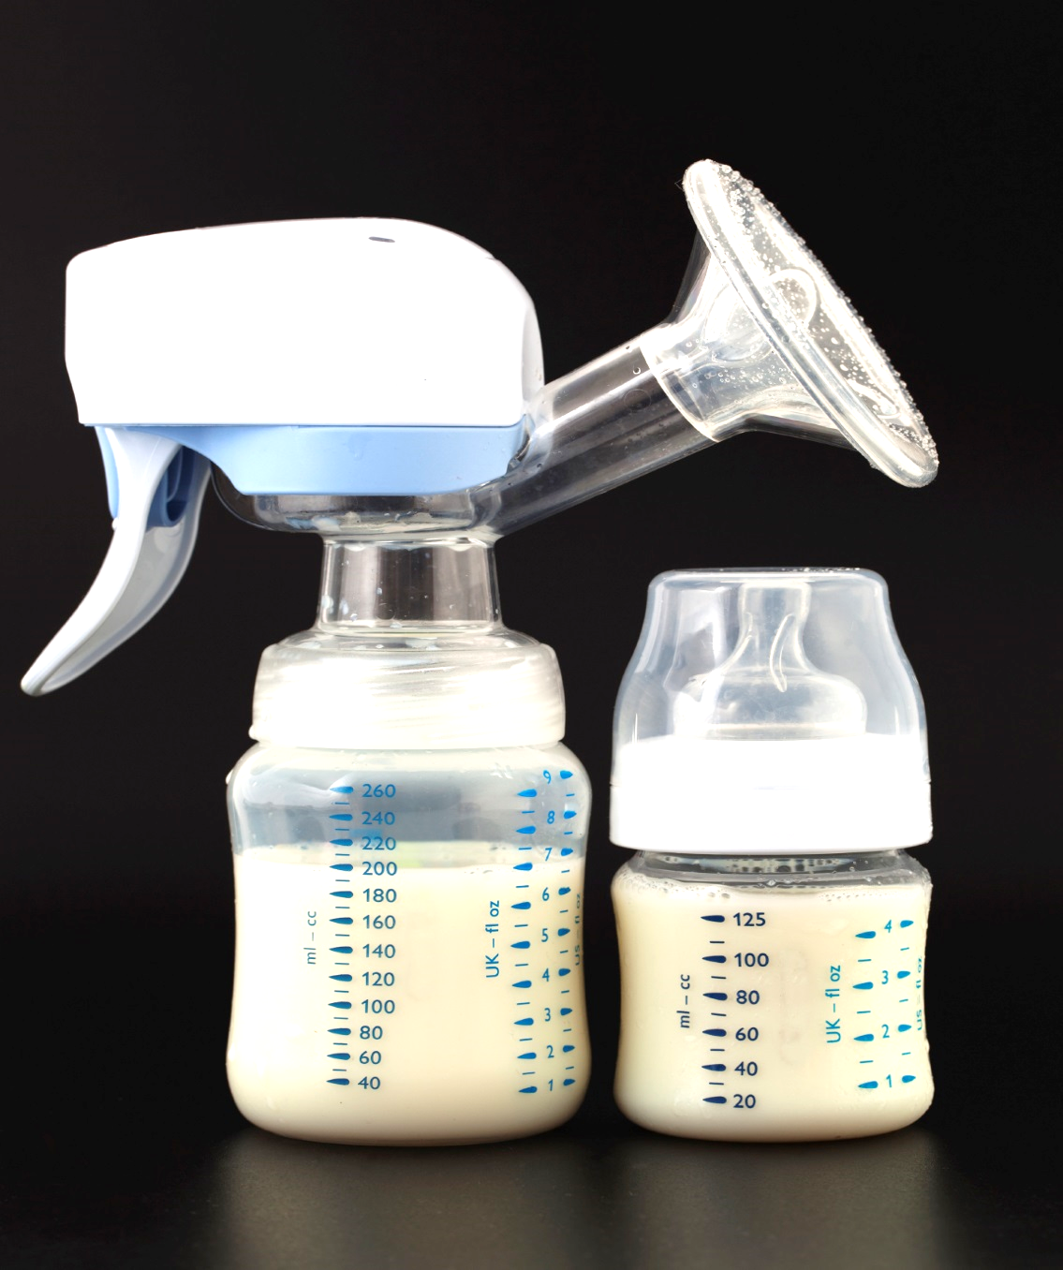
Serving Expressed Milk
Breastfed infants may not consume the entire serving
Reimbursable:
Offer less than the minimum serving size of breastmilk
Offer additional breastmilk later, if infant will consume more
Feed on demand
Notes:
When serving expressed milk, there may be times when an infant does not consume the entire serving. For example, some breastfed infants consume less than the minimum serving size of breastmilk for each feeding. In these situations, you may offer infants less than the minimum serving size of breastmilk. However, you must offer the additional breastmilk later, if the infant will consume more, for a reimbursable meal.
Although not new, it is important to note infants should be fed on demand and not on a strict schedule. Therefore, feed infants during a span of time consistent with their eating habits. In addition, avoid force-feeding infants, as this may cause them to consume more than they need.

Slide 18
Iron-Fortified Infant Formula
Best supplement for breastmilk
Supports healthy brain development & growth
Reimbursable meals may include:
Iron-fortified formula
Breastmilk
Combination of both
Notes:
When infants are not breastfed or they need a supplement for breastmilk, iron-fortified infant formula is the best alternative. Iron is a very important nutrient for infants during their first year because it supports healthy brain development and growth.
The infant meal pattern requirements allows an infant, younger than 12 months, to be served iron-fortified formula, breastmilk, or a combination of both. Therefore, if a mother wishes not to breastfeed or is unable to produce enough breastmilk to satisfy the infant, iron-fortified formula should be served in place of or in in supplement to breast milk.

Slide 19
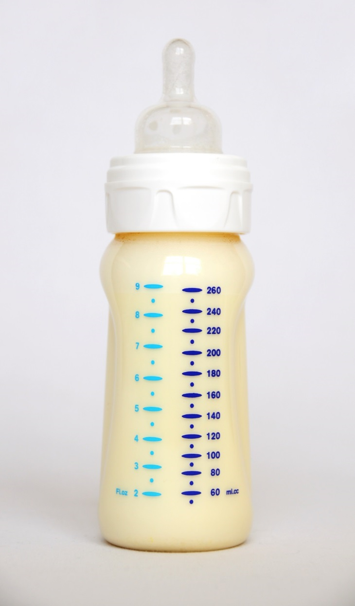
Supplying Formula
Offer a minimum of 1 type of iron-fortified infant formula
Formula must be regulated by FDA
May not credit if purchased outside U.S.
Notes:
All child care programs must continue to offer a minimum of one type of iron-fortified infant formula. When selecting formula, all infant formula must be regulated by the Food and Drug Administration (FDA) to be creditable in the CACFP. Any iron-fortified infant formula bought in a store in the U.S. and all formula marketed in the U.S. is regulated by FDA. However, formula purchased outside of the U.S. may not be regulated by FDA. Therefore, these formulas may not be creditable in the CACFP.

Slide 20
Serving Formula
Infants may not drink the entire serving of formula
Reimbursable as long as the minimum serving size is offered
Any leftovers should be properly stored in accordance with local health and safety requirements
Feed on demand
Notes:
When serving formula, some infants may not consume the entire serving. However, as long as you offer the minimum serving size, the meal is reimbursable. As previously mentioned, the minimum serving size may be offered over a period of time rather than in a single setting as long as what is offered is consistent with the infant’s eating habits and is appropriately documented. A participant does not need to consume the minimum serving size of a food component in order for the meal to be reimbursable. Any leftovers should be properly stored based on your local health and safety requirements.

Slide 21
Disabilities & Substitutions
Modifications must be made for infants with disabilities who need accommodations
A medical statement must be on file to receive reimbursement
Explain the need for the modification
Provide guidance for the substitution or meal modification
Notes:
Due to a disability, some infants may not be able to consume breastmilk or iron-fortified infant formulas. In situations when an infant, child, or adult participant has a disability, you must make reasonable modifications to meal service. To receive reimbursement for milk substitutions or other meal modifications that are outside of the meal pattern requirements due to a disability, the modifications must be supported by a written medical statement signed by a State recognized medical authority, such as a physician, who is authorized to write medical prescriptions under State law (State recognized medical authority). The statement should:
explain the need for the modification,
provide guidance for the substitution or meal modification, and
be kept on file by the CACFP center or family child care home.
Please reach out to a nutrition program specialist if you have additional questions regarding a request for modification due to a disability. Remember, centers MUST provide reasonable modifications for children with disabilities – parents cannot be required to provide their own modification and/or pay for the modification that a center is implementing. Additionally, a center may not simply deny program participation based on an identified disability.

Slide 22
Fruits & Vegetables
Notes:
Now that we have discussed breast milk & formula, let’s move on to discuss the fruits & vegetable components.

Slide 23
Vegetables & Fruits
Great source of essential nutrients
i.e., fiber & vitamin C
Minimum serving size: 0-2 tbsp.
Required at all meals & snacks
Serve vegetable, fruit, or a combination of both
Increases consumption & allows for better acceptance later in life
Notes:
There are two significant updates to the fruit & vegetable component of infant meals. Vegetables and fruits are great sources of essential nutrients, such as fiber and vitamin C. Currently, vegetables and fruits are required at breakfast, lunch, and supper meals for infants who are developmentally ready to accept them (around 6 months of age). In the updated infant meal pattern requirements, 0-2 tablespoon(s) of vegetables, fruits, or a combination of both must be offered during snacks when infants are developmentally ready to accept them. This change promotes vegetable and fruit consumption in infants, and it allows for better acceptance later in life.

Slide 24
Juice
X
Lacks dietary fiber found in other forms of fruits & vegetables
No longer credits toward a reimbursable meal for infants
Notes:
The second change to the fruit & vegetable component of the infant meal pattern centers around juice. Juice lacks the dietary fiber found in other forms of fruits and vegetables. When infants drink too much juice, they are more likely to experience diarrhea, abdominal pain, and other gastrointestinal problems. Therefore, the updated meal pattern requirements no longer credits juice as a reimbursable item for infant meals.

Slide 25
Meat/Meat Alternates
Notes:
The next component that we will discuss is meat/meat alternates.

Slide 26
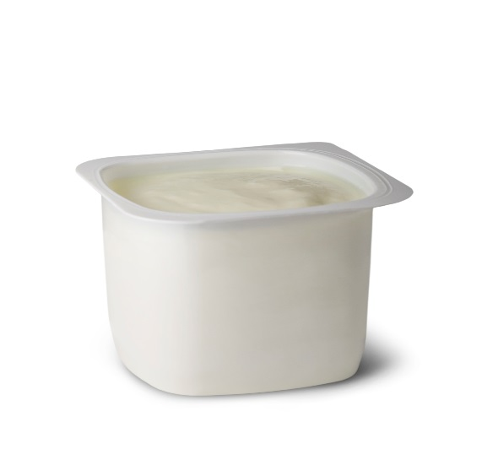
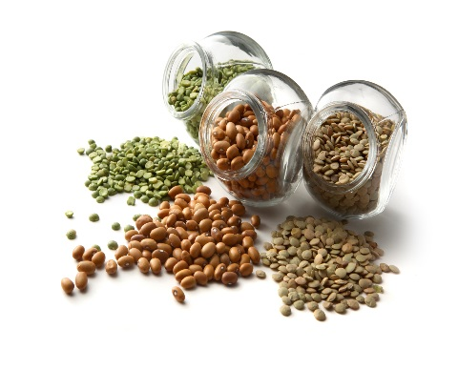
Meat/Meat Alternates
Poultry & other meats
Yogurt
Cheese
Whole Eggs
Dry beans
Notes:
Some common examples of meat/meat alternates include poultry, meat, yogurt, cheese, whole eggs, and dry beans. The updated meal pattern requirements for the meat/meat alternate component focus on yogurt, whole eggs, and cheese foods and spreads. Let’s begin by exploring yogurt.

Slide 27
Yogurt
Great source of protein
Minimum serving size: 0-4 oz
Maybe served during breakfast, lunch, or supper
Must meet the new sugar requirements
Notes:
Yogurt is a great source of protein, and this macronutrient provides energy, builds and maintains muscle, and it promotes a healthy metabolism. Because of the benefits of protein and the popularity of yogurt, the updated meal pattern requirements now allow yogurt as a meat alternate for infants as they are developmentally ready to accept it. When serving yogurt, offer 0-4 ounces during breakfast, lunch, or supper meals. Note that all yogurts included as part of a reimbursable meal in CACFP must contain no more than 23g of sugar per 6 ounces of yogurt. For more information on this requirement, please refer to the yogurt handout and/or the recorded meat/meat alternate webinar available on the RIDE child nutrition website.

Slide 28
Whole Eggs
AAP found no convincing evidence to delay foods considered major food allergens
Whole eggs are now creditable for infant meals
Minimum serving size: 0-4 tbsp.
Notes:
Eggs are a great source of protein. Previously, there was a concern that the protein in egg whites may cause an allergic reaction. However, the AAP recently concluded that there is no convincing evidence to delay the introduction of foods that are considered major food allergens, such as eggs. Therefore, the updated infant meal pattern requirements allow 0-4 tablespoons of whole eggs to credit towards a reimbursable meal.

Slide 29
Cheese
Minimum serving size: 0-2 oz
Cheese & cottage cheese
Common examples
Shredded or sliced Swiss, Colby, & Monterey Jack
Notes:
Next, 0-2 ounces of cheese and cottage cheese credit as a meat alternate in the updated infant meal pattern. Some common examples of cheese may include shredded or sliced Swiss, Colby, and Monterey Jack.

Slide 30
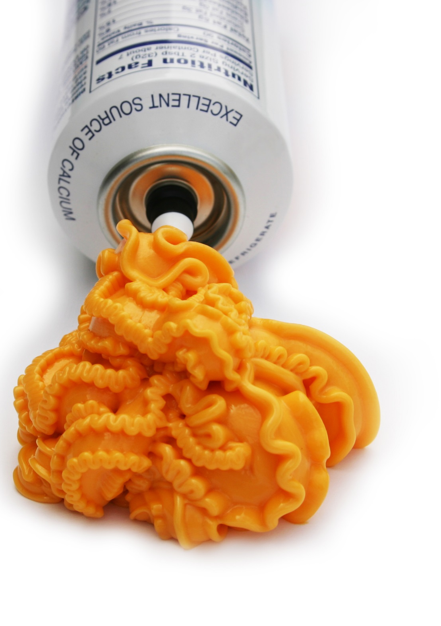
Cheese foods & cheese spreads are disallowed for infant meals & snacks…
Notes:
However, certain cheese items have significantly higher amounts of sodium than others. Eating too many foods high in sodium can lead to heart disease, stroke, and hypertension. Therefore, the updated infant meal pattern requirements disallow the service of cheese foods or cheese spreads for infant meals. It is important to note, cheese foods are still allowable for children and adults but not for participants under 1 year of age.

Slide 31
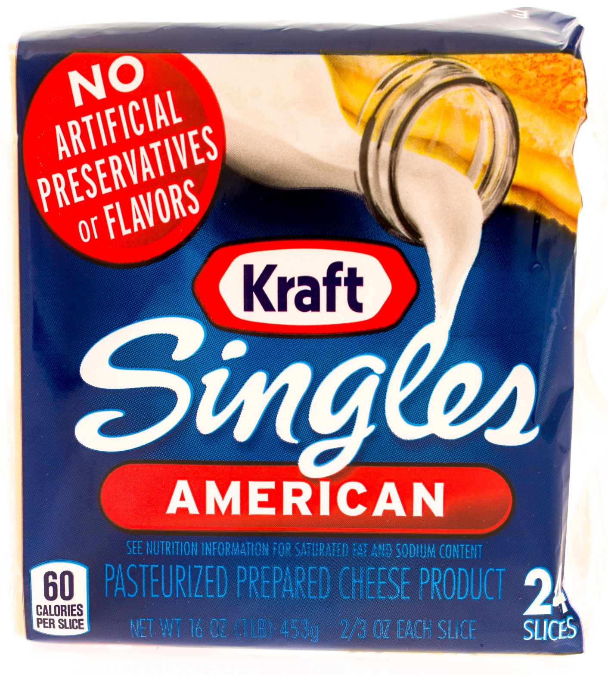
Non-Creditable Cheese Foods
Product packaging states:
“Imitation cheese”
“Cheese food”
“Cheese product”
Common items
Cheese whips
Cheese with pimento
Cream cheese
Notes:
Non-creditable items may be identified by reading the product’s packaging for the wording “imitation cheese,” “cheese food,” or “cheese product” on the food label, such as:
cheese whips,
cheese with pimento, and
cream cheese.
Refer to the USDA Food Buying Guide for Child Nutrition Programs or the USDA crediting handbook to help you identify approved cheese items.

Slide 32
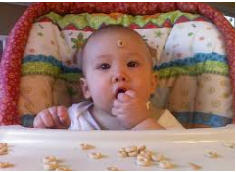
Grains & Infant Cereal
Notes:
The last component that we will discuss is the grains component.

Slide 33
Grains & Infant Cereals
Iron-fortified infant cereals are often the first solid foods:
Often easiest to digest
Least likely to cause an allergic reaction
Serve at meals & snacks when infants are developmentally ready
Minimum serving size: 0-4 tbsp.
Notes:
During the first year, grains, such as iron-fortified infant cereals, can be a great source of essential nutrients, such as B vitamins, zinc, and magnesium.
Iron-fortified infant cereals are often the first solid foods introduced to infants because they are easily digested and are filled with essential nutrients. When infants are developmentally ready, serve 0-4 tablespoons of iron-fortified infant cereal for a reimbursable meal.

Slide 34
Snack Meals Only
Bread, crackers, & ready-to-eat breakfast cereals
Ready-to-eat breakfast cereals: No more than 6 grams of sugar per dry oz
Notes:
The updated infant meal pattern requirements allow breads, crackers, and now, ready-to-eat cereals to credit for snack meals only. When choosing to serve ready-to-eat cereals at snack, it must contain no more than 6 grams of sugar per dry ounce to be reimbursable. For more information on the sugar requirement for cereals, please refer to the cereal handout and/or grains webinar recording available on the child nutrition program website.

Slide 35
Developmental Readiness
Notes:
Now that we have reviewed each of the components of the infant meal pattern, let’s move on to discuss developmental readiness.

Slide 36
Developmental Readiness
Introducing solid foods too early:
cause choking
consume less breastmilk or formula
Serve solid foods when infants are developmentally ready
Notes:
Introducing solid foods is a very important step for infants, parents, and guardians. It is vital that infants are developmentally ready for solid foods before introducing them. Introducing solid foods too early may cause infants to:
choke on the food because they are not physically able to consume solid foods, and
consume less breastmilk or formula and not get enough calories and other nutrients for proper growth and development.
Therefore, it is important to serve solid foods to infants when they are developmentally ready.

Slide 37
American Academy of Pediatrics
Developmental Readiness Guidelines
Sits in chair with good head control
Opens mouth for food
Moves food from a spoon into throat
Doubles in birth weight
Notes:
The American Academy of Pediatrics (AAP) is the leading authority for children’s development and nutrition needs from birth through 23 months of age. They found that there is no direct signal to determine when an infant is developmentally ready to accept solid foods. However, the AAP provides these guidelines to help determine when an infant is developmentally ready to accept solid foods when the infant:
is able to sit in a high chair, feeding seat, or infant seat with good head control;
opens their mouth when food comes their way. The infant may watch others eat, reach for food, and seem eager to be fed;
moves food from a spoon into the throat; and
doubles in weight.

Slide 38
Parent Communication
Working with parents helps to
Ensure newly introduced foods are most ideal
Be consistent with eating habits
Support developmental readiness
Always consult with parents/guardians first before serving solid foods
Notes:
Working with parents or guardians helps to ensure that all newly introduced foods are appropriate for each individual infant and are consistent with their eating habits and developmental readiness. Always consult with parents or guardians about when and what solid foods to introduce to infants. When communicating with parents and guardians, you may wish to use the AAP’s developmental readiness guidelines as a way to show the infant may be ready for solid foods.

Slide 39
Optional Written Statement
Request a written statement from parents or guardians:
outlining when & which solid foods to serve
Follows the preferences of parents & guardians
Notes:
Additionally, it is recommended that providers request a written statement from parents or guardians, outlining when and which solid foods to serve to each infant. This optional statement will help you to know what to do to meet the needs of the infants and follow the preferences of parents and guardians. This documentation can also be useful in the administrative review process to demonstrate that each infant is being fed according to his or her individual feeding habits.

Slide 40
Providing Food Components
Parents/guardians may provide only one creditable food component for a reimbursable meal
i.e., provide breastmilk = 1 component
Child care providers must provide remaining components
Notes:
When discussing infant feeding habits with parents, it is also a great time to discuss the food parents or guardians may wish to provide. Previously, a parent or guardian could provide all but one component and the meal was still reimbursable. However, the updated meal pattern requirements allow parents and guardians to provide only one food component for a reimbursable infant meal. If parents/guardians wish to provide more than one component, the meal would then not be reimbursable. Note that breast milk, either expressed or from a mother breast-feeding on site, will count as the one parent-provided component for infant meals.
Although infants have unique dietary needs and parents or guardians are often most in touch with their infant’s dietary preferences, this change will help ensure child care settings are not encouraging or requiring parents or guardians to supply the food in order to reduce costs. Specifically, it helps maintain the integrity of the CACFP.

Slide 41
Introducing Solid Food(s)
Once an infant shows signs of developmental readiness, solid foods must be offered
Gradually introduce solid foods
One at a time
Over the course of a few days
Notes:
Once an infant is developmentally ready to accept solid foods, you must offer the food(s) to the infant. Begin by gradually introducing solid foods, one at a time, and over the course of a few days. Because solid foods are introduced gradually, this means that when an infant is just starting to eat solid foods, it may be appropriate to offer solid foods at only one meal per day. An infant does not need to be offered a solid food component that is a part of the meal pattern, such as vegetables and fruit, until the infant has established a tolerance for that food component.

Slide 42
Introducing Solid Food(s) (cont.)
Prepare foods in the right texture and consistency
Observe infants closely for reactions after feeding a new food
Notes:
In additional to the gradual introduction to solid foods centers should also:
prepare foods in the right texture and consistency, appropriate for the age and development of each infant; and
observe each infant closely for reactions after feeding a new food. If there is a reaction, stop feeding the food and discuss this with the parents or guardians. Consult with the parents or guardians, who should contact their baby’s doctor, before introducing that food in the future.

Slide 43
Optional Best Practices

Slide 44
Best Practices & the CACFP
Designed to further improve the nutritional quality of all meals
Optional, but highly encouraged
Ensures children & adults get optimal benefits from meals
Non-compliance does not cause:
Meal disallowance
Serious deficiency finding
Notes:
In addition to the revision of the CACFP meal pattern requirements, USDA developed best practices that build on the meal pattern requirements to further improve the nutritional quality of all meals. The best practices reflect recommendations from the Dietary Guidelines for Americans and the National Academy of Medicine.
The best practices are optional. However, USDA highly encourages all CACFP centers and day care homes to implement these best practices in order to ensure children and adults are getting the optimal benefit from the meals served. Failure to comply with the best practices cannot result in a meal disallowance or a serious deficiency finding.

Slide 45
Infants
Support mothers who choose to breastfeed
Encourage mothers to supply breastmilk
Provide a quiet, private area, that is comfortable, safe, & sanitary
Notes:
As we learned, breastfeeding is the ideal source of nutrients for infants because it provides the essential nutrients needed for healthy growth and development. As a best practice, child care providers are encouraged to support mothers who choose to breastfeed their infants by:
encouraging mothers to supply breastmilk while their infant(s) are in child care; and
providing a quiet, private area, that is comfortable, safe, and sanitary for mothers to breastfeed at the facility.

Slide 46
Best Practices Action Plan
Builds on the meal pattern requirements
Shows your commitment to those in your care
Establish & implement a plan
CACFP
Notes:
As we have discussed, the best practices are designed to build on the meal pattern requirements. Although they are not required, implementing the best practices shows your commitment to going the extra mile to ensure those in your care are provided nutritious meals. Fortunately, implementing the best practices can be made easy when you establish a plan and put it into action. Whether you choose to implement these best practices or not, your center should develop an overall action plan for implementing the new meal pattern. Having a clear plan will help you and your staff to understand the requirements and ensure compliance throughout the menu planning, shopping, preparation and meal serving process.

Slide 47
Documenting Compliance
Notes:
Now that we have reviewed the changes to the new CACFP meal pattern, let’s talk about how to document your center’s compliance.

Slide 48
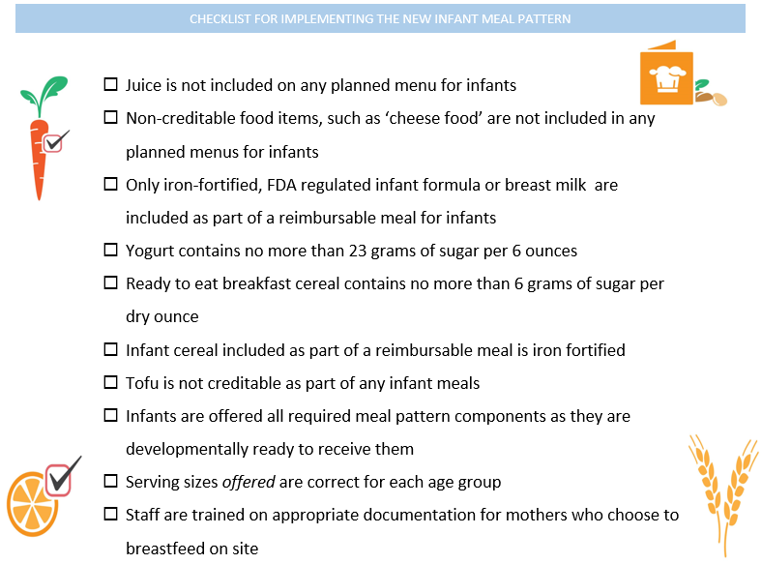
Notes:
Before we look at specific examples of acceptable infant documentation, let’s review the checklist for implementing the new infant meal pattern.
This hand out is available on the RIDE child nutrition website.

Slide 49
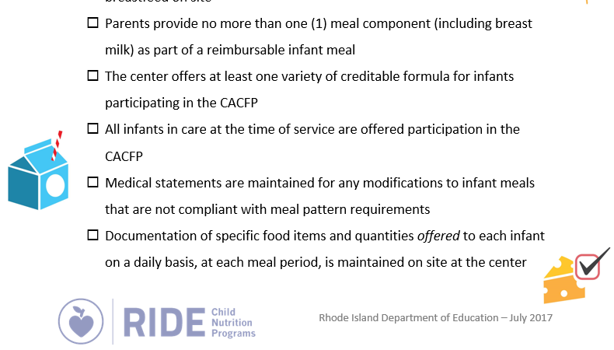

Slide 50
Sample Infant Documentation
Individual by infant
Includes the infant’s name and date of birth
Documents the amount of food offered at each meal period
Includes specific information on the food items served (i.e. ‘applesauce’ vs. ‘fruit’)
Denotes any parent-provided meal components
Is maintained on site at the center for at least 3 years plus the current year
Notes:
Now that we have reviewed the compliance checklist, we will move on to look at some samples of acceptable infant documentation.
Appropriate documentation for infant feeding in the CACFP will meet all of the criteria as shown on the screen.
Note that there is no one required form that must be used by centers when documenting infant meals. Many, if not all, centers are already producing individual documentation for each infant based on what is consumed at each meal period. It is acceptable to edit existing forms used in the center as long as all required CACFP information is recorded. Just remember, for CACFP documentation what the infant is offered as opposed to what the infant actually consumes is required. Additionally, this documentation must be maintained on site at the center and be available for review by RIDE child nutrition program staff, so if you are producing documentation that is then sent home with the family and a copy is not maintained on site at the center, this would not meet CACFP requirements.

Slide 51
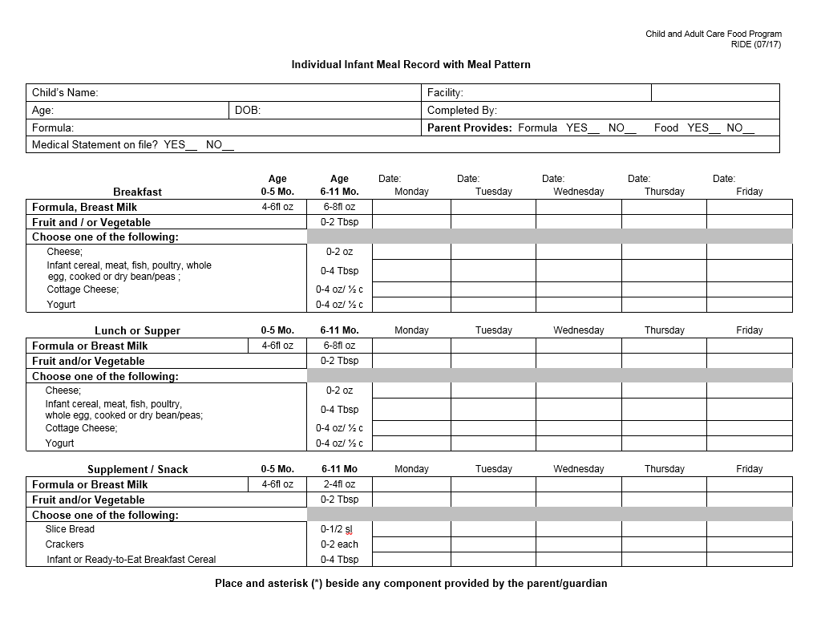
Notes:
The most comprehensive sample infant documentation form, shown on the screen, closely mimics the 5 day menu template that RIDE provides for implementation of the CACFP child meal patterns.
This form is available in Word format and could be printed including all of the relevant information on the top portion of the form (child’s name, DOB, etc.) in advance of service. Then, the teach would be responsible only for indicating the type and quantity of food items served on each day.

Slide 52
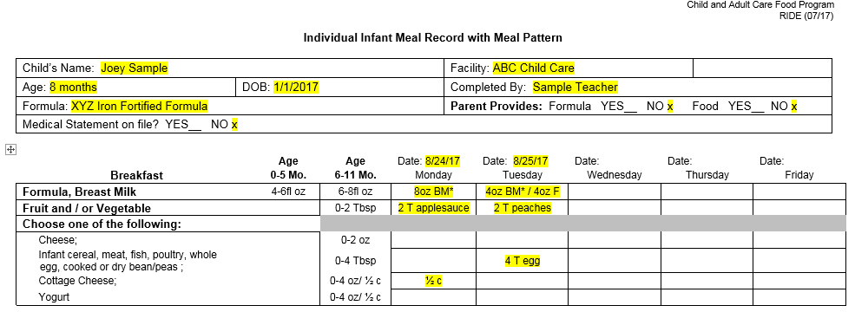
Notes:
When used correctly, all required information on the top of the form is filled out completely.
The date has been entered ahead of each day.
The first line indicates the amount and uses the letters “BM” to denote breast milk as opposed to formula and also includes an asterisk to indicate that this is the one parent provided component for this meal.
The type of fruit and quantity are specified
½ cup is denoted on the ‘cottage cheese’ line, so no additional information is needed outside of the portion size
Note: on Tuesday in this example the parent did not provide enough breast milk to meet the minimum serving size that the infant is developmentally ready to receive (8oz) and so formula was provided as a supplement to meet the minimum meal pattern requirement. For the meat meat/alternate on this day, the food item served is an egg and is specified along with the quanitity.

Slide 53
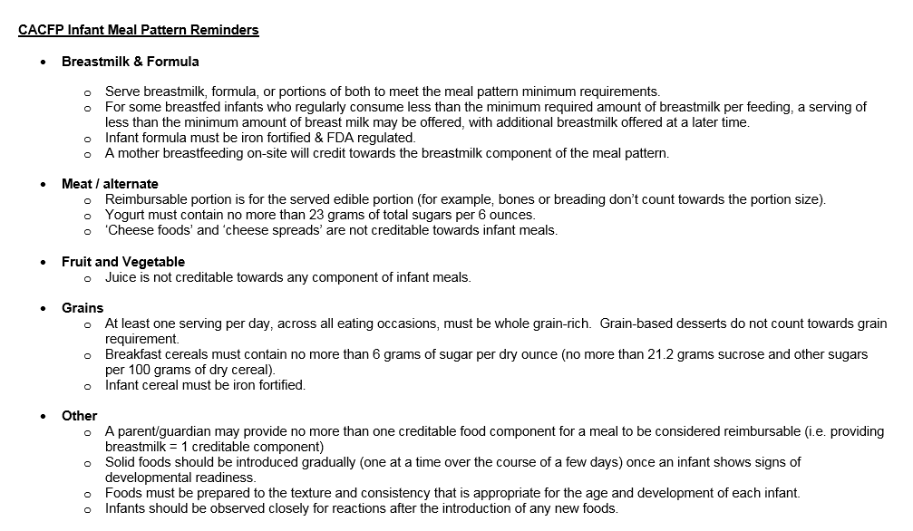
Notes:
This sample form also includes helpful reminders about the new infant meal pattern on the reverse side. Even if you do not elect to use this sample form, you may want to consider printing out these reminders for use in infant classrooms.

Slide 54
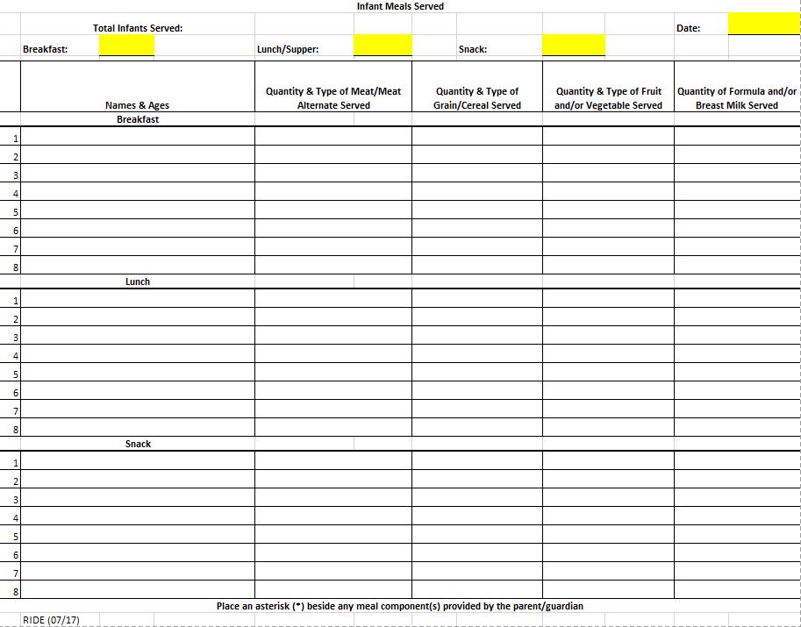
Notes:
Some centers may choose to reduce the amount of paperwork required for infant documentation and will elect to document multiple infants on one form for each serving day.
This form does not contain information on the minimum required serving sizes and so teachers must be well-trained and/or have alternate resources available to provide them with this information.

Slide 55
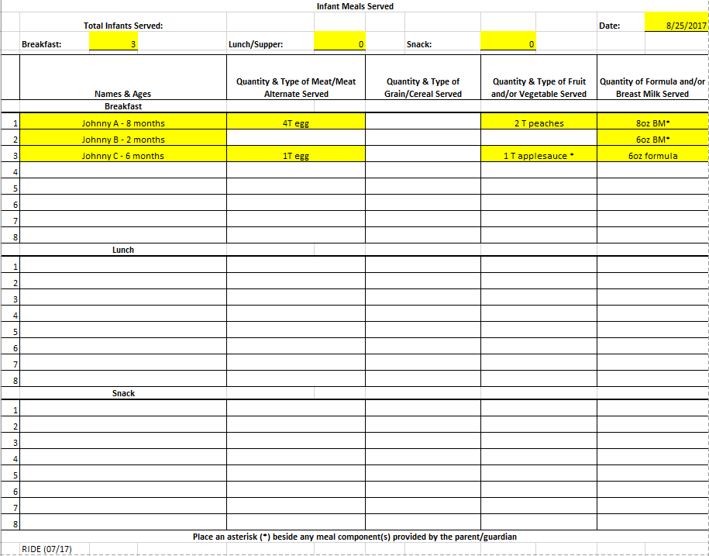
Notes:
In this example, the teacher completes the date at the top of the form and fills out the information for each infant served at each meal period. The top of the form provides a spot for totaling CACFP meals served to help with the claiming process.
Infant names and ages could be typed into the form ahead of time to save time when documenting meal service, however, be sure that only the students actually in attendance and served a meal are counted.
Notice that “Johnny C” is right at the 6 month age when he would likely be showing signs of developmental readiness for solid foods. As long as the serving sizes recorded are consistent with the infant’s eating habits and developmental readiness, this meal would still be considered reimbursable. Also note that for Johnny C, the parent-provided component is applesauce. Because Johnny is given formula provided by the center and so applesauce is the only parent-provided component, this meal would be considered reimbursable. If his parents had provided both applesauce and breastmilk, this meal would not reimbursable under CACFP guidelines and should not be included in the meal count total.
Remember, parents may elect to provide components as part of a reimbursable meal under CACFP but cannot be REQUIRED to provide any components as part of this program.

Slide 56
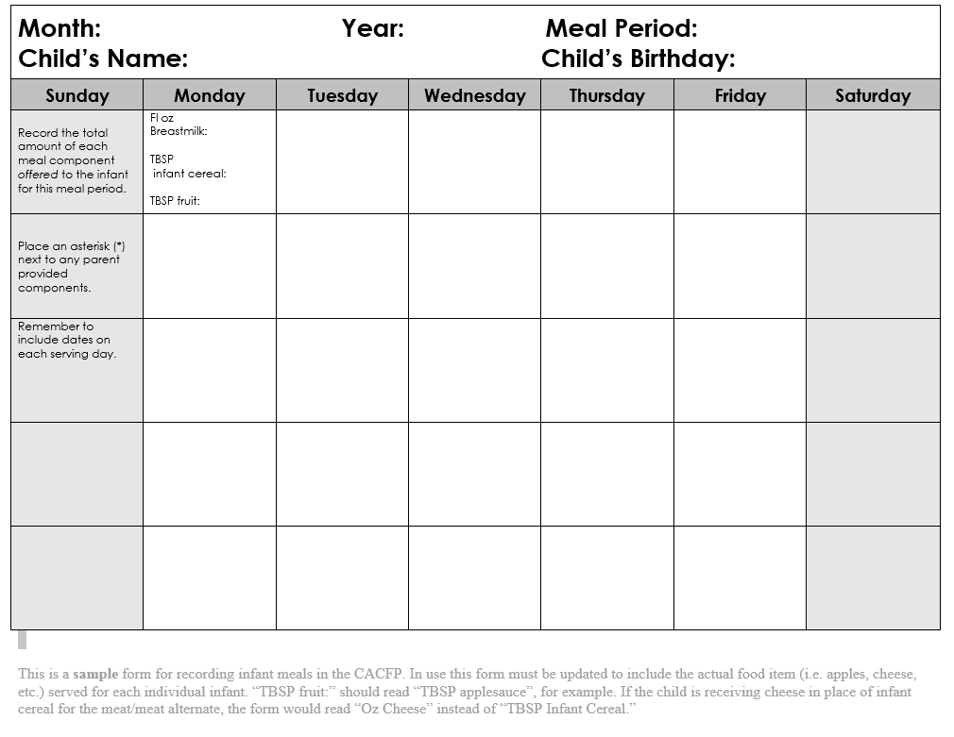
Notes:
One final example of infant documentation that a center might be used is shown on the screen. This form would allow a center to keep one piece of paper per infant, per meal period, per month for the purposes of documenting infant meals.
Again, this sample does not provide teachers with the minimum meal pattern requirements and would required specific training to ensure that the form is filled out completely and correctly.

Slide 57
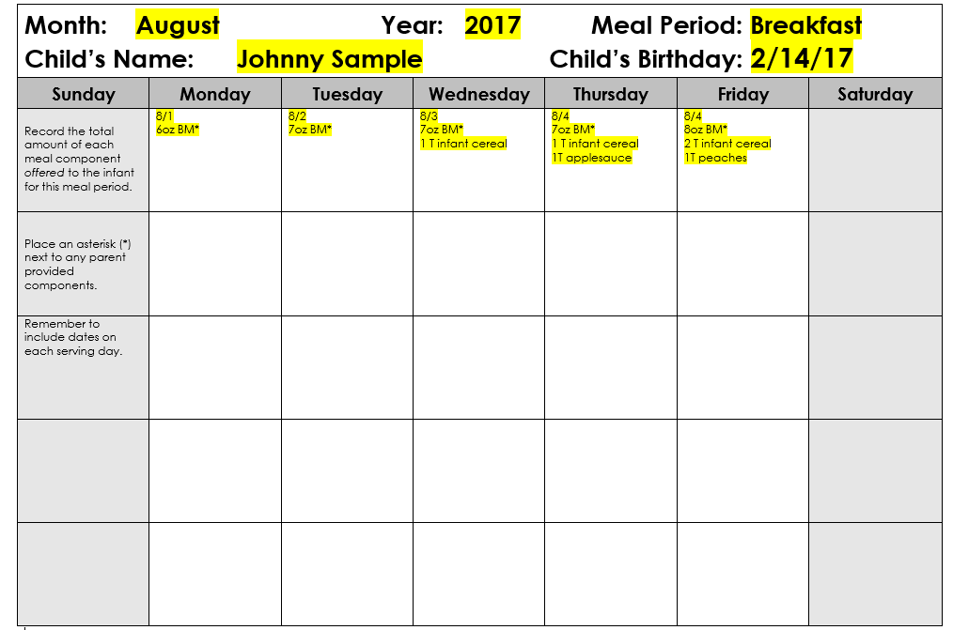
Notes:
In this example our sample infant is right around the 6 month mark. The meals documented continue to include the specific food item and quantity offered each day.
Because Johnny is just showing signs of developmental readiness, you can see that additional foods are introduced slowly but that each day is consistent with and/or builds upon the prior serving day’s habits, increasing until the meal pattern requirements are met. Because these meals are consistent with the infant’s eating habits and are driven by his developmental readiness ques, along with parent communication, these meals would all be considered reimbursable.
A pattern that shows continued introduction of solid foods in increasing amounts but then suddenly reverts back to breastmilk only would not be considered consistent with the infant’s eating habits and would likely be questioned on review. If a situation like this were to arise as a result of communications with the parent, a best practice would be to document that conversation (either in the infant’s file or directly on the meal recording form) to prevent the disallowance of meals during an administrative review.

Slide 58
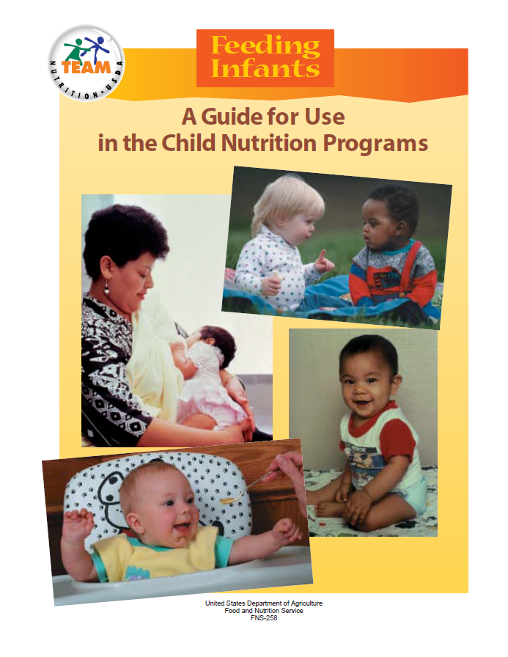
: Reimbursable Infant Meals
Resources
http://www.ride.ri.gov/CNP/NutritionPrograms/ChildandAdultCareFoodProgram.aspx#21441420-new-meal-pattern-
Notes:
Copies of each of these sample documentation forms as well as additional infant resources can be found on the RIDE child nutrition website at the link shown on the screen.
As I mentioned, there is no one required form that must be used for infant meal documentations. Centers may elect to create their own forms but are encouraged to seek RIDE approval before implementation to ensure compliance.
In addition to saving individual infant meal documentation, remember that RIDE may also requests nutrition labels for the iron-fortified infant formula in use and for yogurt and cereal (to confirm compliance with sugar requirements).
This concludes the training on the new infant meal patterns for the Child and Adult Care Food Program. Please contact a RIDE program specialist with any questions.

